Slide 1
Progressive damage analysis of composite laminates with big cutouts
Pengcheng Chu,Zheng Li, Jianlin Chen
College of Engineering, Peking University
State Key Laboratory for Turbulence & Complex Systems
2017.08.20

Slide 2
Content
1
Background
2
Failure Simulation
3
Results and Comparing
4
Conclusions
Notes:
This presentation consists of four parts.

Slide 3
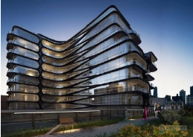
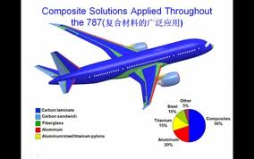
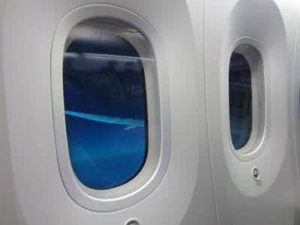
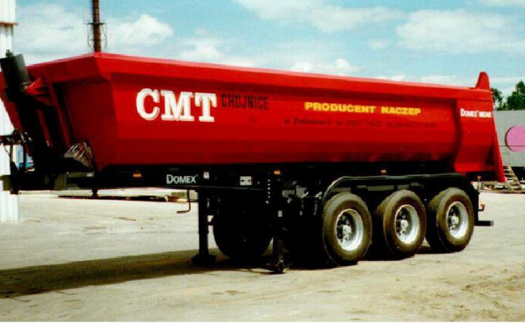
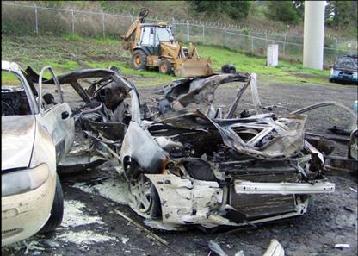
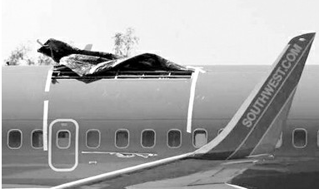
1. Background (i)
Wide Use of Composite Materials
Damage of Composite Materials
Notes:
as we know,In the recent years, composite materials have been increasingly used in many different fields like aerospace, constructions because of their remarkable strength, stiffeners, weight. Also, there are many composite laminates with big cutouts to be designed and applied, such as in aircraft structures for the gate and window on the fuselage, hatch opening, etc.
However, the stress concentration and the complicated failure modes around the cutout are difficult to be studied. The progressive failure process induced by the stress concentration needs to be thoroughly investigated because it is essential for predicting the performance of composite structures and designing reliable and safety structures.

Slide 4
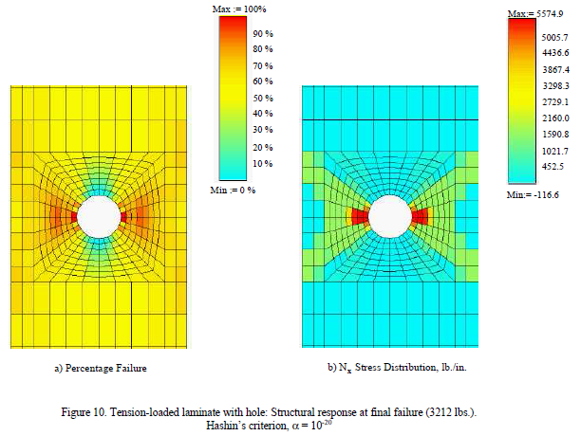
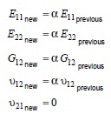
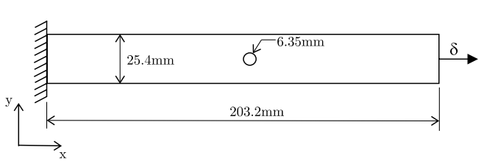
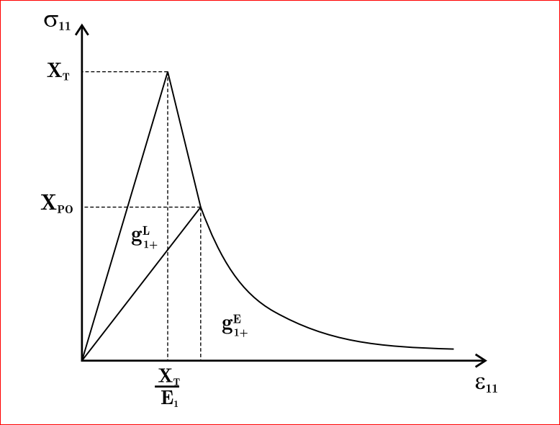
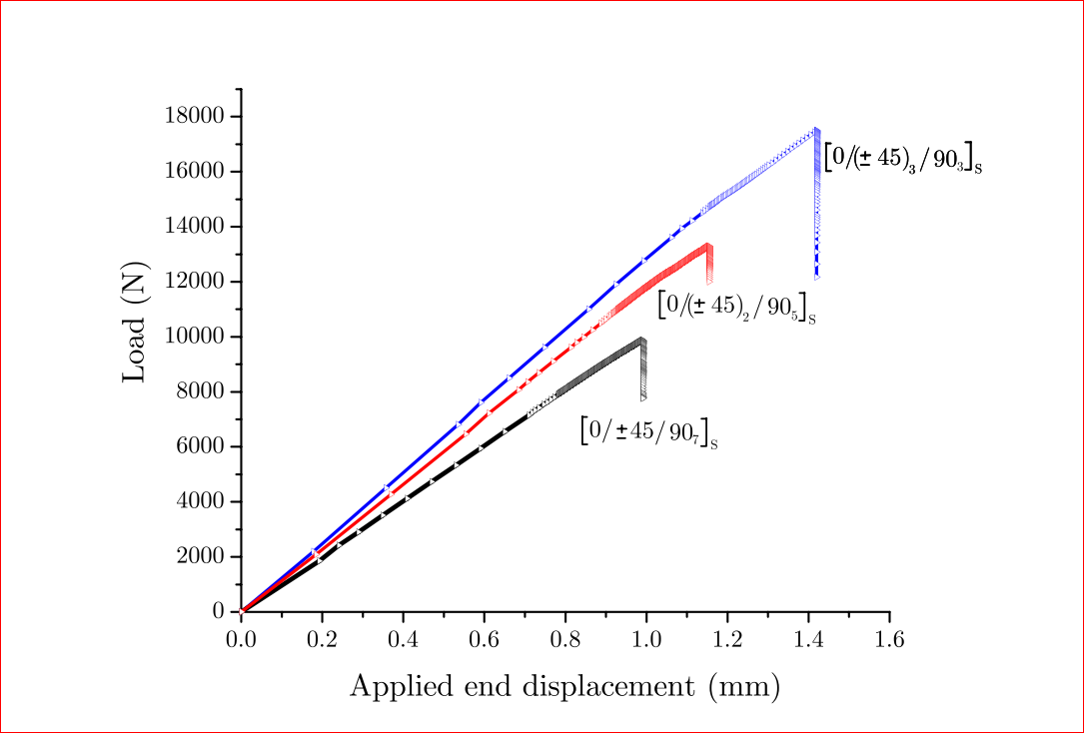
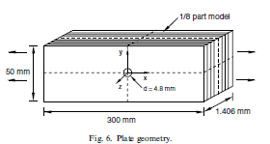
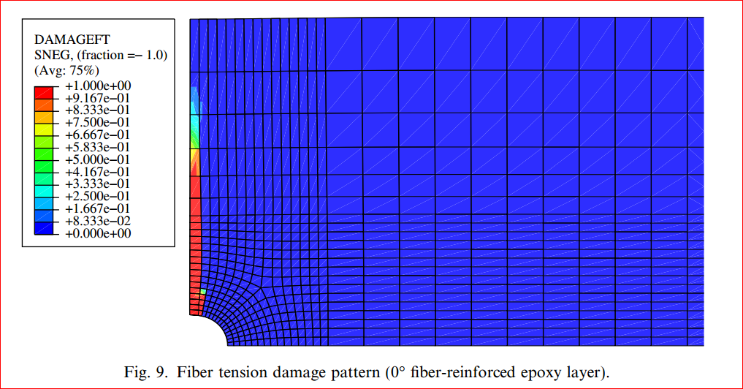
1. Background (ii)
David W.Sleight,NASA /TP-1999-209107
ply-discount method
Wang Danyong,2005
Whitney JM, Nuismer RJ.1974
fracture mechanics model
P.P. Camanho,2012
continuum damage model
Ireneusz Lapczyk,2007
P. Maimi,2007
Notes:
There are 3 main methods, the first method is ply-discount method, we simply degrade the stiffness coefficient with alpha, However, the alpha is uncertain. the is a semi-empirical method and require calibration. The second method is based on fracture mechanics, it performs well for the small hole situation, but in the case of the big cutouts, the stress state become more complicated. The third method is continuum damage model, this model is based on continuum damage mechanics and do not require calibration. This method define the damaged stiffness matrix using the damage variables. Some simulation has been completed but most of them just for the problem of small hole

Slide 5
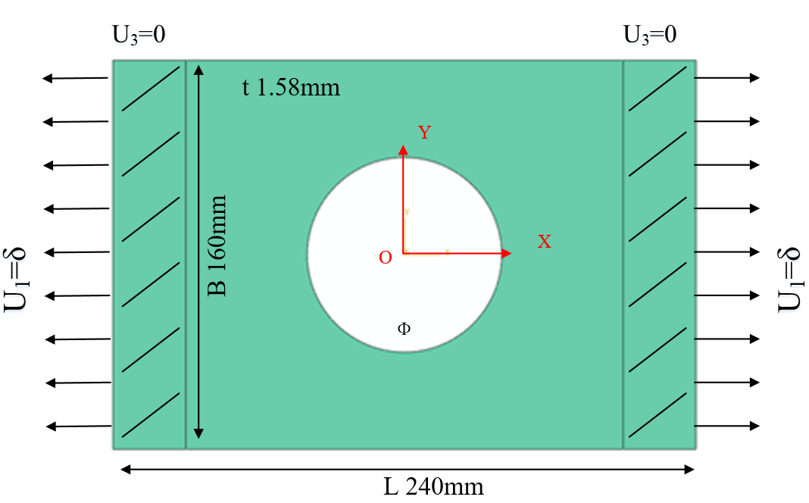
2. Failure Simulation (i)
Simulation Model
FEM：Abaqus
Model: 3D Shell(SC8R)
Strength criterion：Hashin
Ф: 60mm, 80mm, 100mm
Layups: [0˚]₁₀, [0˚/90˚]₅, [±45˚]₅
Table 1 Material properties of a single lamina
ρ（kg/m³） | E₁(GPa) | E₂(GPa) | G₁₂(GPa) | υ₁₂
1520.7 | 127.70 | 9.67 | 6.50 | 0.30
Table 2 Strength parameters of a single lamina
Strength | X_{t} | X_{c} | Y_{t} | Y_{c} | S₁₂
(MPa) | 1528.7 | 764.3 | 36.0 | 160.3 | 180.5
Notes:
The composite laminates with different lay-up and different sizes of big cutouts are considered to figure out the failure behaviors of composite laminates.
Here, we only consider the composite laminates with three kinds of lay-up ([0]10, [0°/90°]5, [45°/-45°]5 ) and the laminates have the size of 240mm in length and 160mm in width. In the center, the diameters of circular cutouts are 60mm, 80mm, and 100mm separately.

Slide 6
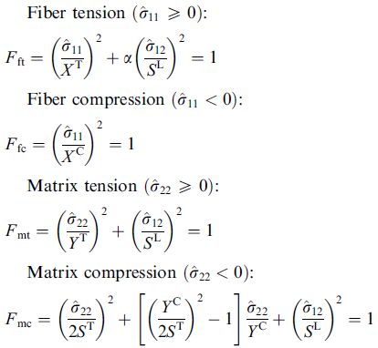
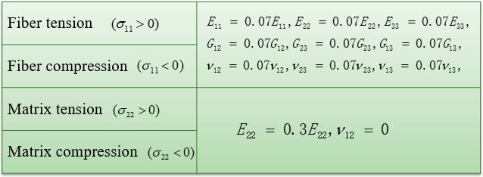
2. Failure Simulation (ii)
Failure Model 1: ply-discount method
Hashin criterion
Stiffness reduction model:
Wang Danyong, Wen Weidong, Cui Haitao. Three-Dimensional progressive damage analysis of composite laminates containing a hole subjected to tensile loading. Chinese Journal of Theoretical and Applied Mechanics, 2005, 37(6):788-795.
Notes:
We choose two diffrent Damage model to compare with each other,The first is ply-discount method,the reduction factor we use is refer to this paper. The failure criterion is well-known Hashin criterion,this criterion has four failure type：fiber tension,fiber compression, matrix tension,matrix compression.

Slide 7
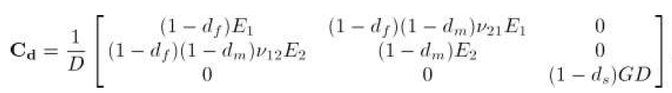
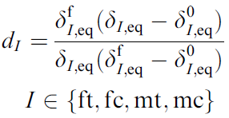
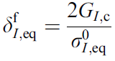
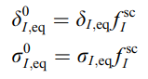
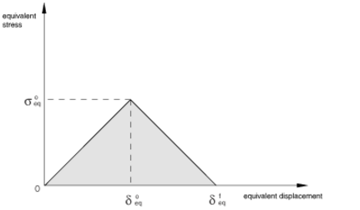
2. Failure Simulation (iii)
Failure Model 2: Continuum Damage Model
Hashin criterion
The Continuum Damage Model:
Damage variable:
Lapczyk I, Hurtado J A. Progressive damage modeling in fiber-reinforced materials[J]. Composites Part A Applied Science & Manufacturing, 2007, 38(11):2333-2341.
Notes:
the second model we use is the Continuum Damage Model, The failure criterion is also Hashin criterion.The Continuum Damage Model defined the damage stiffness matrix using the damage variables,The sigmal is equivalent stress,the deata is equivalent displacement.The G is fracture energy. The d is between 0 and 1, it is 0 when there is no failure, it is 1 when the ultimate damage occur.

Slide 8
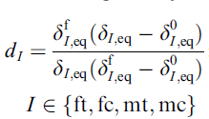
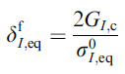
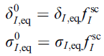
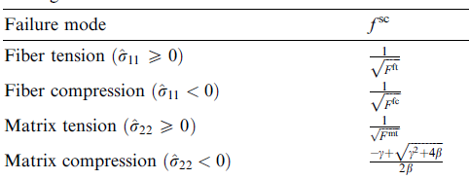
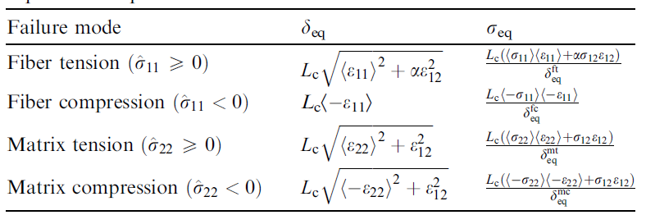
2. Failure Simulation (iv)
Damage variables calculation：
damage variables:
Jaccobian matirx:
Notes:
The detail of the calculation of damage variables is here, the expression of the damage variables derive from these formulas are formed of .......

Slide 9
2. Failure Simulation (v)
abaqus UMAT ：
after each increment
UMAT subroutine
calculate strain and undamaged stiffness matrix
calculate damage variable d and
calculate stress
damaged
calculate damaged stiffness matrix
checkout failure ( Hashin
criterion)
undamaged
calculate stress and Jacobian matirx; update damage variable d
quit UMAT,back to main program
Notes:
The process of the Umat subroutine in Abaqus is shown in the flow diagram.
partial derivative

Slide 10
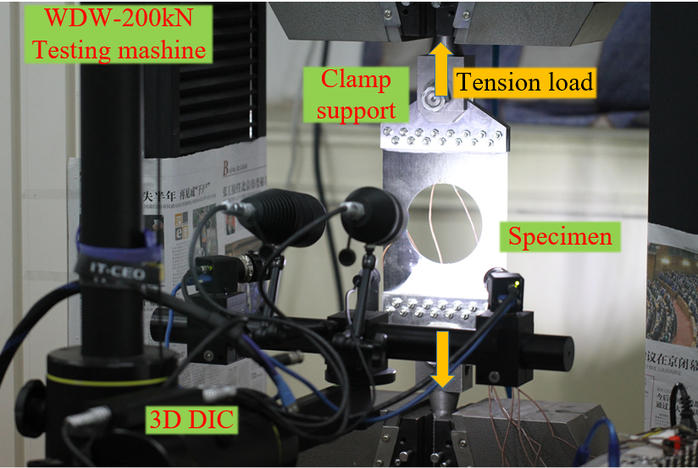
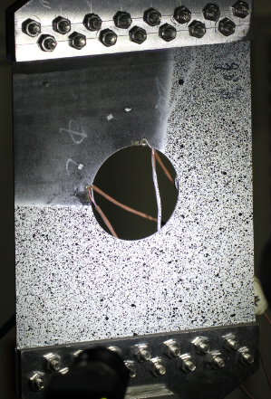
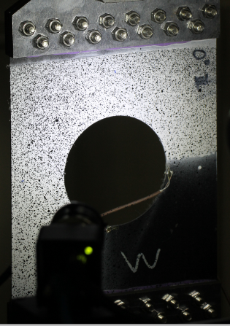
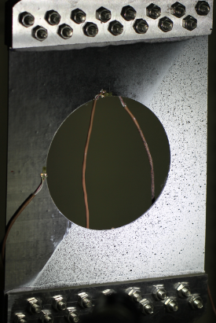
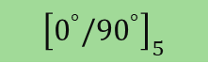


3. Results and Comparing (i)
Experiment system
Layup sequences
$${\left[0^{°}\right]}_{10}$$
$${\left[0^{°}{/90}^{°}\right]}_{5}$$
$${\left[{±45}^{°}\right]}_{5}$$
Loading mode
Displacement control by 0.5mm/min
DIC speckle
PMBLAB DIC-3D system Pro
Camera: 2448*2048pix
Pictures: 1f/Kn
Correlation algorithms: ZNSSD
Cutouts:（a）Ф60mm （b）Ф80mm （c）Ф100mm
Notes:
This is the Experiment system we use,this is a uniaxial tension experiment,the speed is set as 0.5mm/min
Strain indicator is used to measure the strain.

Slide 11
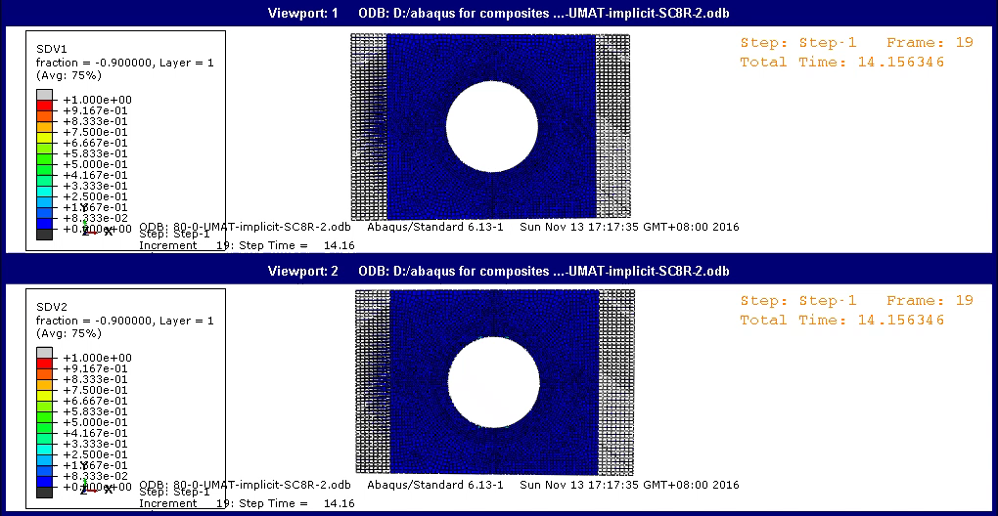
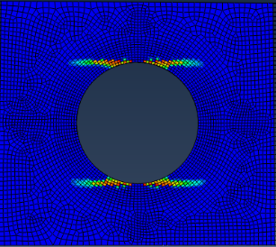
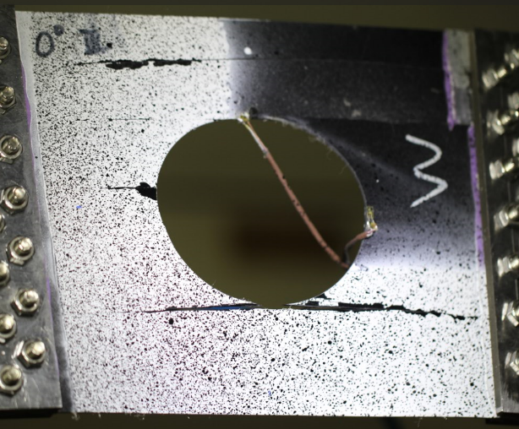
3. Results and Comparing (ii)
[0]₁₀ & Ф80mm (using Continuum Damage Model)
Fiber failure
Matrix failure
Notes:
This is the failure behavior of the 0 layup laminates。The fiber failure is shown in the animation above. The matrix failure is shown in the animation below, it extends along the 0 degree direction, The simulation results agree with experimental results.

Slide 12
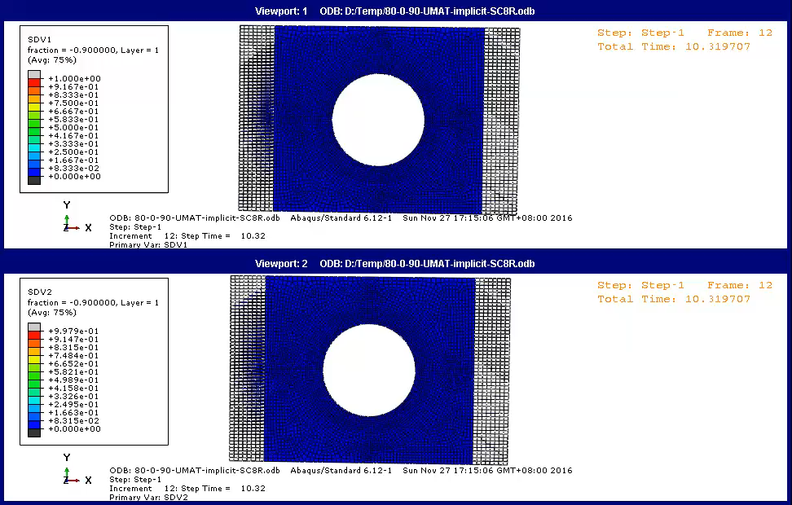
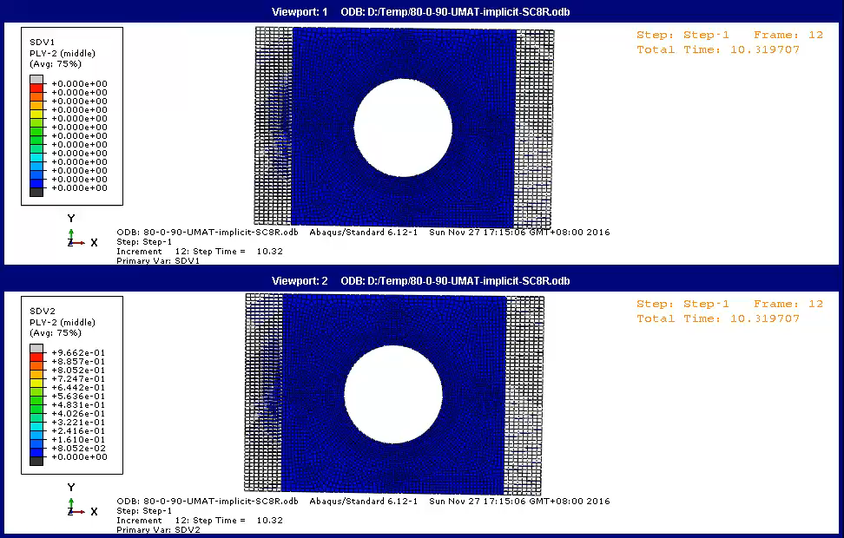
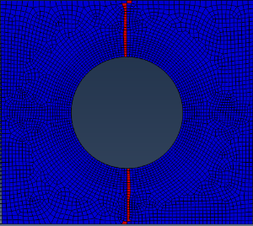
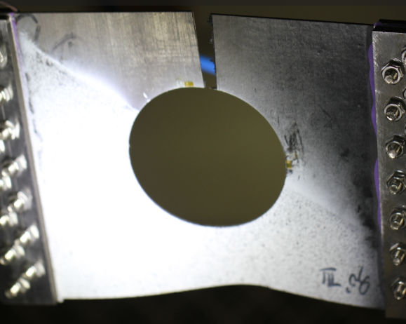

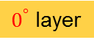
3. Results and Comparing (iii)
[0/90]₅ & Ф80mm (using Continuum Damage Model)
Fiber failure
Fiber failure
Matrix failure
Matrix failure
$0^{°}$ layer
${90}^{°}$ layer
Notes:
This is the failure behavior of the 0/90 layup laminates. The fiber failure is shown in the animation above. The matrix failure is shown in the animation below,The left one is 0 layer,the right one is 90 layer. In the 0 layer,we can see that the fiber failure extends along the 90 direction,and the matrix failure also extends on the either sides of the fiber failure.In the 90 layer,there is only matrix failure without any fiber failure.

Slide 13
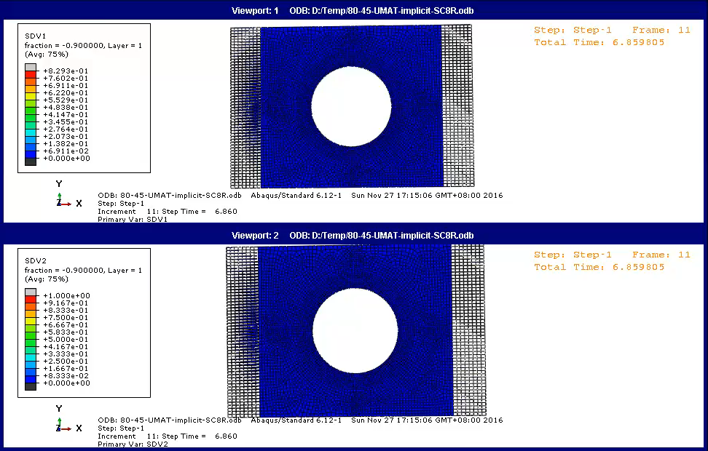
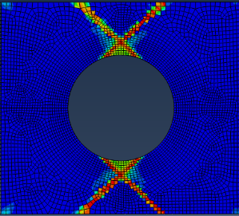
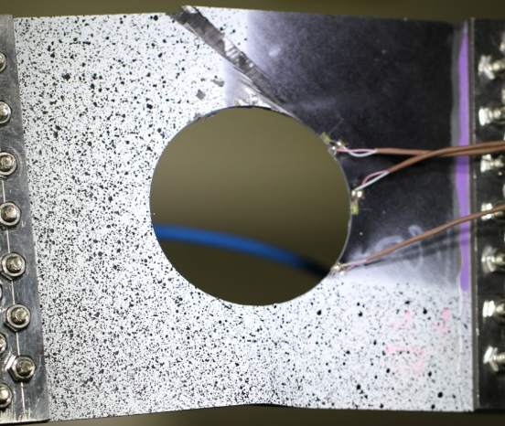
3. Results and Comparing (iv)
[±45]₅ & Ф80mm(using Continuum Damage Model)
Fiber failure
Matrix failure
Notes:
This is the failure behavior of the 45 layup laminates.The matrix failure extends along the 45 direction.The simulation agree with the experimental results.

Slide 14
3. Results and Comparing (v)
The ultimate strength: (using ply-discount method)
)
Comparing of Ultimate loads Layer | Size of cutout (Ф)
 | 60mm |  |  | 80mm |  |  | 100mm
 | Simul. | Exp. | Relative error | Simul. | Exp. | Relative error | Simul. | Exp. | Relative error
[0]₁₀ | 97.69 | 78.23 | -19.9% | 76.11 | 69.73 | -8.4% | 52.82 | 35.00 | -34%
[0/90]₅ | 56.91 | 59.32 | 4.0% | 45.89 | 47.20 | 2.8% | 32.99 | 37.54 | 12.1%
[±45]₅ | 22.46 | 28.72 | 21.8% | 17.89 | 23.79 | 24.8% | 13.42 | 17.60 | 23.8%
Simulation
Experiment
Ф80 cutout

Slide 15
3. Results and Comparing (vi)
The ultimate strength of Ф80 cutout:
Ultimate load （kN） Layer | Exp. | Continuum Damage Model
 |  | Simulation | Error
[0]₁₀ | 69.73 | 86.98 | 24.73%
[0/90]₅ | 47.20 | 45.37 | 3.88%
[±45]₅ | 23.79 | 14.31 | 39.85%
Ply-discount Model
Simulation | Error
76.11 | -8.4%
45.89 | 2.8%
17.89 | 24.8%
Continuum Damage Model
Ply-discount Model
Experiment
Notes:
The numerical results of ultimate strength correlate well with the experimental data as show in Figure 1.
The force-displacement curves in the simulation results exhibit the brittle failure of the composite laminates as the experiment shows.
Convergence problem.

Slide 16
4. Conclusions(i)
Based on the simulation and experiments:
Failure onset is at the stress concentration area,ultimate strength is effected by the design of ply sequences and decreases with size of cutout increase;
The simulation using the continuum damage model exhibit the brittle failure of the composite laminates as the experiment shows,while the ply discount method can only predict the ultimate strength of composite laminates;
The continuum damage model preforms well for predicting the failure behavior of composite laminates with big cutouts;
The finite element based failure model of composite laminates can be used in composite structures with arbitrary configurations under complex stress states to make up for the shortage of analytical failure analysis.
Notes:
3、The initial and growth of failure in simulation results show that the continuum damage model preforms well for predicting the failure behavior of composite laminates with big cutouts.
4、The finite element based failure model of composite laminates can be used in composite structures with arbitrary configurations under complex stress states to make up for the shortage of analytical failure analysis such as fracture mechanics model.

Slide 17
Thank you very much！

